Slide 1
Chapter 16. Applying Patterns to Design a State Diagram Editor
Adapter
Chain of Responsibility
Decorator

Slide 2
Adapter Pattern

Slide 3
Adapter Pattern
Adapter Pattern: Connects incompatible components.
  It converts the interface of one component into another interface expected by the other (calling) component
  Used to provide a new interface to existing legacy components (Interface engineering, reengineering)
Also known as a wrapper.
Notes:
The adapter pattern lets classes work together that couldn’t otherwise because of incompatible interfaces
Object adapters are much more frequent.
We will only cover object adapters (and call them therefore simply adapters)

Slide 4
Adapter Pattern
Problem
  Want to use an existing class but its interface does not match the one needed
Solution
  Convert original interface into the needed interface through an adapter class
The Adapter pattern has two forms
  class adapter
  object adapter
16-<number>

Slide 5
Adapter Pattern
New System
Old System
(“Legacy System”)
Client
ClientInterface
LegacyClass
Request()
ExistingRequest()
adaptee
Adapter
Request()
Notes:
Delegation is used to bind an Adapter and an Adaptee (Legacy Class)
Interface inheritance is use to specify the interface of the Adapter class.
Adaptee (usually called legacy system) pre-exist the Adapter.
Client Interface may be realized as an interface in Java.

Slide 6
Class Adapter and Object Adapter
Client IF
Adaptee
Client IF
Client
Client
request()
request()
operation()
inheritance
composition
Adapter
Adapter
request()
request()
adaptee
...
adaptee.operation();
...
Adaptee
...
operation();
...
operation ()
Adaptee 1
Adaptee 2
Class Adpater
operation()
operation()
Object Adpater
16-<number>

Slide 7
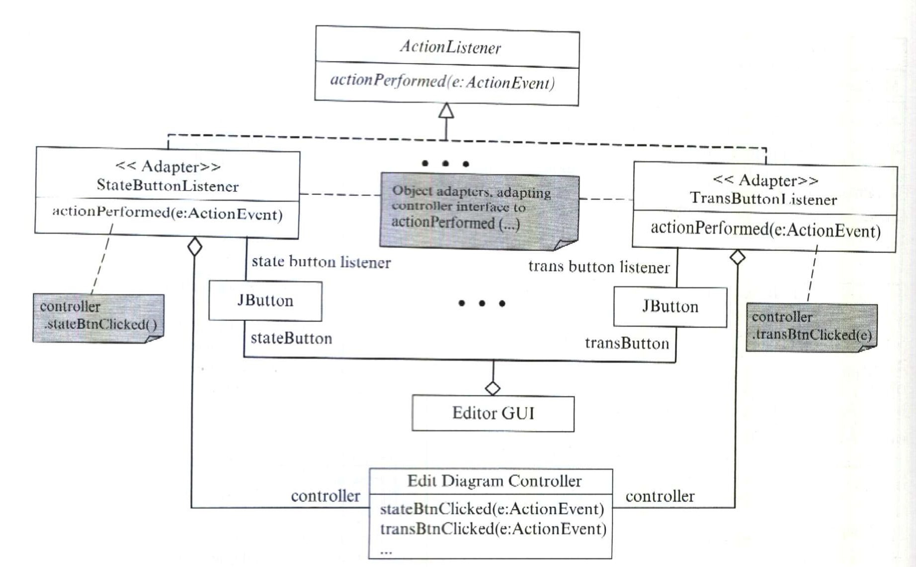
16-<number>

Slide 8
Class Adapter and Object Adapter
Class adapter
  commit to a concrete adaptee class
  can override behavior of the adaptee class
  introduces only one object
  cannot change the adaptee class at run time
  can add functionality to the adaptee class
Object adapter
  do not commit to an adaptee class
  may introduce a subclass of the adaptee class and override its behavior
  introduces more than one object
  can change the adaptee at run time
  can add functionality to the adaptees through subclassing
16-<number>

Slide 9
A Class Adapter Example
Problem
  An application program wants to read from an ascii file using
    readString()
    readChar()
    readInt()
    etc.
  But Java IO does not provide this convenience
  How can we do?
    implement an adapter class to convert the needed interface to an appropriate Java API
16-<number>

Slide 10
A Class Adapter Example
AsciiInputInterface
Client
readString(): String
readChar(): char
readInt(): int
...
StreamTokenizer
sval: String
nextToken(): int
String result=“”;
if (nextToken()==TT_EOF) {
throw new EOFException();
} else if (ttype != TT_WORD) {
throw new IOException
("Not a string!");
} else {
result=sval;
checkEolEof();
return result;
}
AsciiInputInterfaceAdapter
readString(): String
readChar(): char
readInt(): int
checkEolEof()
...
16-<number>

Slide 11
Pluggable Adapters
*
File
Class0
subClasses():String[]
NormalFile
Directory
list():String[]
Class1
Class2
A directory hierarchy
An inheritance hierarchy
How do we design a generic display that can display any hierarchical structures?
The solution is using pluggable adapters.
16-<number>

Slide 12
Pluggable Adapters
HierarchicalDisplay
Client/Target
getChild(n:Node):Node
createGraphNode(n:Node)
display()
buildHierarchy(n:Node)
Directory
ClassHierarchy
Adapters
DirectoryDisplay
InheritanceTreeDisplay
getChild(n:Node):Node
createGraphNode(n:Node)
getChild(n:Node):Node
createGraphNode(n:Node)
16-<number>

Slide 13
Chain of Responsibility Pattern

Slide 14
Chain of Responsibility
Design problem: How do we process requests when the exact handlers are not know in advance?
Example applications:
  purchase order approval hierarchy
  exception handling
  business rules processing
  providing context dependent help
16-<number>

Slide 15
Context Dependent Help
Using if-then-else or case statement
  if (context==X)
  showHelp1()
  else if (context==Y)
  showHelp2()
  else if ...
  This solution has high cyclomatic complexity.
  It is difficult to change.
  New context dependent help cannot be added dynamically.
16-<number>

Slide 16
Chain of Responsibility
if (successor!=null)
successor.
handleRequest();
else {
// do default handling
}
successor
Handler
has successor
create(next: Handler)
canHandle(): boolean
handleRequest()
Handler 1
Handler K
canHandle(): boolean
handleRequest()
canHandle(): boolean
handleRequest()
Handlers are chained from smaller scope to larger scope.
If a handler cannot handle the request, it passes the request to its successor.
if (canHandle())
/* handle request */
else
super.handleRequest();
16-<number>

Slide 17
Sample Code
public abstract class Handler {
Handler next;
public Handler (Handler next) {
this.next=next;
}
public abstract boolean canHandle();
public void handleRequest() {
if (successor!=null)
successor.handleRequest();
else {
/* do default handling */
}
}
public class HandlerJ extends Handler {
public HandlerJ (Handler next)
{ super(next); }
public boolean canHandle()
{ /* implement this function */ }
public void handleRequest() {
if (canHandle())
/* handle request */
else {
super.handleRequest();
}
}
16-<number>

Slide 18
Chain of Responsibility Pattern
Benefits
  Designing “stupid objects”
    Each concrete handler does only one thing.
    Each concrete handler knows only one successor.
    The handlers do not know what the other handlers do.
  Supporting separation of concerns
    The responsibilities to handle the requests are assigned to different concrete handlers.
  The chain of handlers can be updated dynamically.
Liabilities
  A request may not be handled.
16-<number>

Slide 19
Class Exercise
What are the similarities and differences between
  chain of responsibility and interpreter?
  chain of responsibility and observer?
How can chain of responsibility be used to perform exception handling?
Are there any other uses of Chain of Responsibility?
Can you use this pattern in your project work?
16-<number>

Slide 20
Decorator Pattern

Slide 21
Decorating User Interface
What needs to be done?
  adding a border around the editing area
  adding a vertical and a horizontal scroll bar to allow the user to view different parts of the document
  the system must be able to dynamically add or remove any of these decorations
16-<number>

Slide 22
One Solution Is Using Inheritance
Glyph
Scrolled Area
Bordered Area
...
Bordered Scrolled Area
Inheritance provides only a static solution. The
decoration cannot be changed dynamically.
Unmanageable number of subclasses, due to number
of possible combinations.
The decorations cannot be combined.
16-<number>

Slide 23
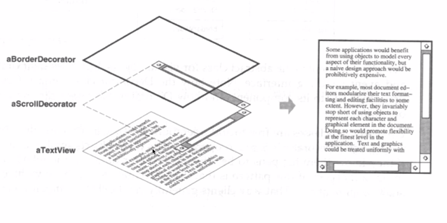
16-<number>

Slide 24
Applying Decorator Pattern – textbook diagram
Diagram Element
name: String
loc: Point
draw(g: Graphics)
intersect(p: Point): boolean
<<Decorator>>
Decorator
draw(g: Graphics)
intersect(p: Point): boolean
component. draw(g);
component
compo-nent
*
super.draw(g);
drawNote (g);
<<Decoroator>>
UML Note
draw(g: Graphics)
drawNote (g:Graphics)
*
State Diagram
draw note
State
Transition
*
16-<number>

Slide 25
Applying Decorator Pattern - Revised
DiagramElement
draw(g: Graphics)
<<Decorator>>
Decorator
DiagramElement de
Decorator(de: DiagramElement)
DiagramElement. draw(g);
component
*
<<Decorator 1>>
UMLNote
UMLNote(de: DiagramElement)
draw(g: Graphics)
super.draw(g);
*
State Diagram
State
Transition
+"draw note….."
*
16-<number>

Slide 26
Expanding the Composite Representation
Composite
Diagram Element
children
Decorator
component
draw(...)
*
component.
draw(...)
Decorator
State
Transition
State Diagram
draw(...)
draw(...)
draw(...)
draw(...)
Scroller
Border
super.draw(...);
drawBorder(...);
draw(...)
drawScroller(...)
draw(...)
drawBorder(...)
Added functionality
Added functionality
super.draw(...);
drawScroller(...);
16-<number>

Slide 27
Decorator Pattern
Component
operation ()
component
component.
operation()
Comp1
Decorator
operation ()
operation ()
Decorator1
Decorator2
super.operation()
addedFunct2()
operation ()
addedFunct1()
operation ()
addedFunct2()
16-<number>

Slide 28
The Decorator Pattern
Adding functionality to an existing object dynamically.
A flexible alternative to subclassing, especially when subclassing is impractical:
  too many subclasses
  cannot be subclassed, e.g., final class
16-<number>

Slide 29
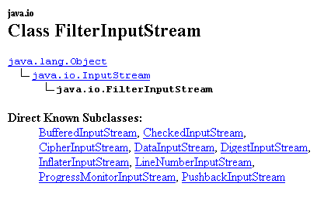
Known Uses
Encrypted, compressed communication streams
Stream I/O:
<-----component to decorate
<-- decorator superclass
16-<number>

Slide 30
Class Discussion
Decorator and Visitor both visit and process the elements of a class hierarchy.
What are the similarities between these two patterns?
What are the differences between these two patterns?
When to apply each of these patterns?
16-<number>

